Slide 1


Scientific Data Science:
Incorporating domain knowledge & other considerations
Organizers:
Maria Han Veiga (MIDAS)
Miles Timpe (UZH)

Slide 2
Agenda
What we will talk about — examples
This also crosses to industry because there’s also domain knowledge
Requires understanding ML
How to incorporate physical knowledge
Interpretability and uncertainty

Slide 3
Motivation
Brunton, S., & Kutz, J. (2019). Data-Driven Science and Engineering: Machine Learning, Dynamical Systems, and Control. Cambridge: Cambridge University Press.
More than 50 years ago, John Tukey envisioned the existence of a scientific effort focused on learning from data.
Data analysis / Data science has been largely dominated by two distinct cultural outlooks on data
Machine learning community: pre-dominantly comprised of computer scientists and typically centered on prediction quality and scalable, fast algorithms
Statistical learning community: often centered in statistics departments, focuses on the inference of interpretable models.
Both methodologies have achieved significant success and
provided the mathematical and computational foundations for data-science methods.
Notes:
Data science itself is not new, having been proposed more than 50 years ago by John Tukey who envisioned the existence of a scientific effort focused on learning from data, or data analysis [152]. Since that time, data science has been largely dominated by two distinct cultural outlooks on data

Slide 4
Motivation
Brunton, S., & Kutz, J. (2019). Data-Driven Science and Engineering: Machine Learning, Dynamical Systems, and Control. Cambridge: Cambridge University Press.
For engineers and scientists, the goal is to leverage these new techniques to infer and compute models (typically nonlinear) from observations:
That correctly identify the underlying dynamics;
Generalize qualitatively and quantitatively to unmeasured parts of phase, parameter, or application space.
Another scientific tool (like numerical simulations)
Much less developed theory
Notes:
Data science itself is not new, having been proposed more than 50 years ago by John Tukey who envisioned the existence of a scientific effort focused on learning from data, or data analysis [152]. Since that time, data science has been largely dominated by two distinct cultural outlooks on data

Slide 5
Tools in science and engineering
Analytical models:
Many processes can be studied through ordinary / partial differential equations
These are often intractable to solve analytically
Numerical simulations:
The numerical solution of these systems is important to study many scientific and engineering problems
Notes:
Non parametric in the sense of we don’t have to specify, for example, the maximal degree of polynomial for the basis, etc. there are still parameters ofc.

Slide 6
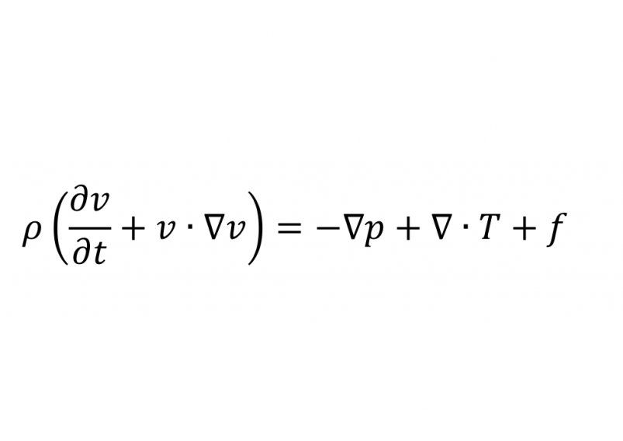
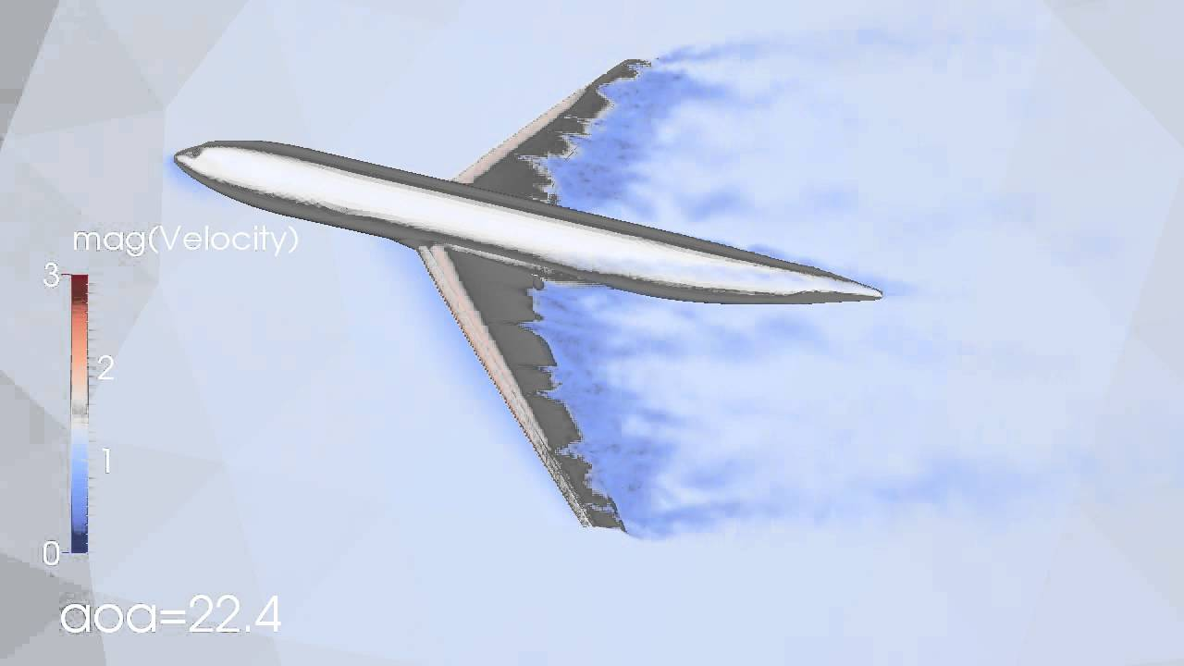
Tools in science and engineering
Analytical models:
Many processes can be studied through ordinary / partial differential equations
These are often intractable to solve analytically
Numerical simulations:
The numerical solution of these systems is important to study many scientific and engineering problems
Notes:
Non parametric in the sense of we don’t have to specify, for example, the maximal degree of polynomial for the basis, etc. there are still parameters ofc.

Slide 7
Uses of ML in scientific context
Improving predictions beyond state-of-the-art physical models
First-principle models are based on known physical laws.
Physical processes are often multi-scale
In most cases, first-principle models are approximations of reality
Uncertain parameters
Simplified (do not solve all scales/account for all physics)
E.g.: smaller scales are introduced by subgrid models
Notes:
Non parametric in the sense of we don’t have to specify, for example, the maximal degree of polynomial for the basis, etc. there are still parameters ofc.

Slide 8
Uses of ML in scientific context
Improving predictions beyond state-of-the-art physical models
Machine Learning methods can be seen as non-parametric function approximators
Can be used to account for missing physics (functional subgrid models)
Can be used to scale-up previously intractable problems
Notes:
Non parametric in the sense of we don’t have to specify, for example, the maximal degree of polynomial for the basis, etc. there are still parameters ofc.

Slide 9
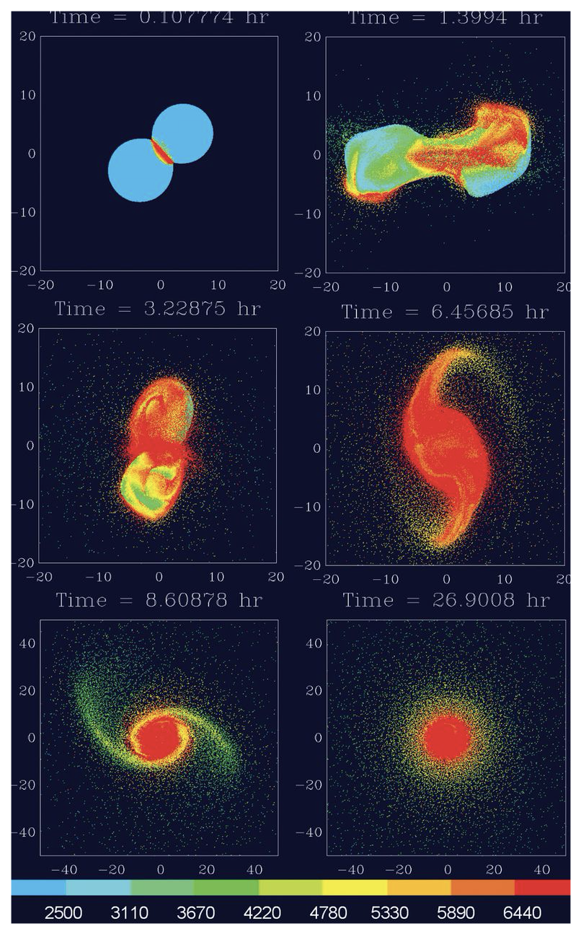
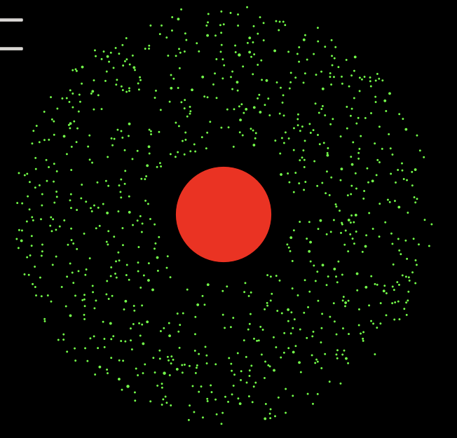
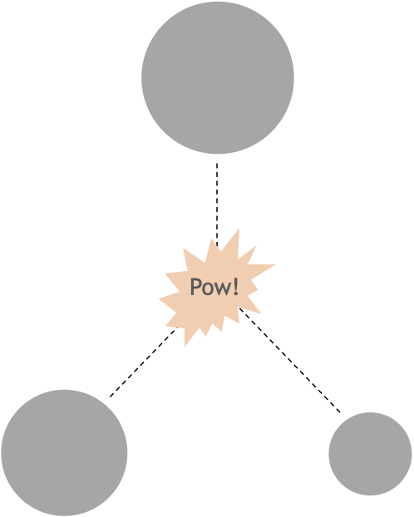
Uses of ML in scientific context
Improving predictions beyond state-of-the-art physical models
Planetary collision
Notes:
Non parametric in the sense of we don’t have to specify, for example, the maximal degree of polynomial for the basis, etc. there are still parameters ofc.

Slide 10
Uses of ML in scientific context
Improving predictions beyond state-of-the-art physical models
Planetary collision
Notes:
Non parametric in the sense of we don’t have to specify, for example, the maximal degree of polynomial for the basis, etc. there are still parameters ofc.

Slide 11
Uses of ML in scientific context
Deep Potential Molecular Dynamics: A Scalable Model with the Accuracy of Quantum Mechanics, L. Zhang et al. Phys. Rev. Lett. 120, 143001, 2018
Improving predictions beyond state-of-the-art physical models
Molecular dynamics is a way of studying the behavior of molecular and material systems by tracking the trajectories of all the nuclei in the system.
Particles obey Newton’s law, with some potential energy function V that models the interaction between particles (nuclei)
The main difficulty is obtaining V:
Compute on the fly using quantum mechanics models (e.g.: density functional theory)
Come up with empirical potentials
Notes:
Ofc the first method is very expensive and it’s pretty much limited computationally to systems of at most 1000 particle s(even in clusters)
The second method is very efficient but unreliable
You start seeing the pattern here – there’s a dilemma between accuracy and efficiency

Slide 12
Uses of ML in scientific context
Deep Potential Molecular Dynamics: A Scalable Model with the Accuracy of Quantum Mechanics, L. Zhang et al. Phys. Rev. Lett. 120, 143001, 2018
The main difficulty is obtaining V:
Compute on the fly using quantum mechanics models (e.g.: density functional theory)
Come up with empirical potentials
In this paper, a neural network is trained to generate an approximation to V, when trained with simulation coming from density functional theory. This way, the accuracy is similar to DFT but it is as efficient as empirical potentials.
Notes:
Ofc the first method is very expensive and it’s pretty much limited computationally to systems of at most 1000 particle s(even in clusters)
The second method is very efficient but unreliable
You start seeing the pattern here – there’s a dilemma between accuracy and efficiency

Slide 13
Uses of ML in scientific context
Surrogate modelling
Replacing expensive computation by a surrogate model
Given input and outputs, learn the mapping without having to solve computationally expensive models
Notes:
Work miles

Slide 14
Uses of ML in scientific context
Storage
Numerical simulations produce a lot of data
Use machine learning techniques to choose what data to keep, what data is redundant

Slide 15
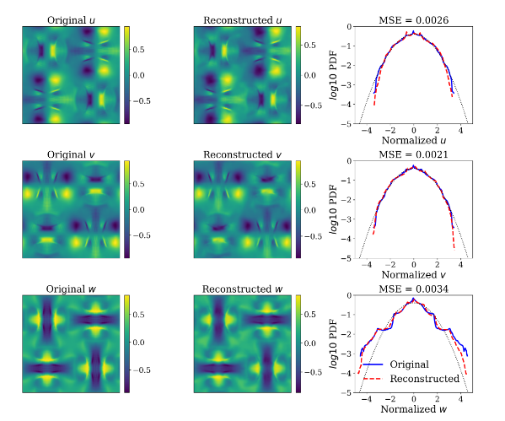
Uses of ML in scientific context
Dimension Reduced Turbulent Flow Data From Deep Vector Quantizers, M. Momenifar et al., arXiv:2103.01074
Finding a data-driven low-dimensional representation of the data
Compression ratio of 85 (ratio between original size and compressed one)
Predictions faithfully reproduce most statistics of the flow
Leads to more efficient storage

Slide 16
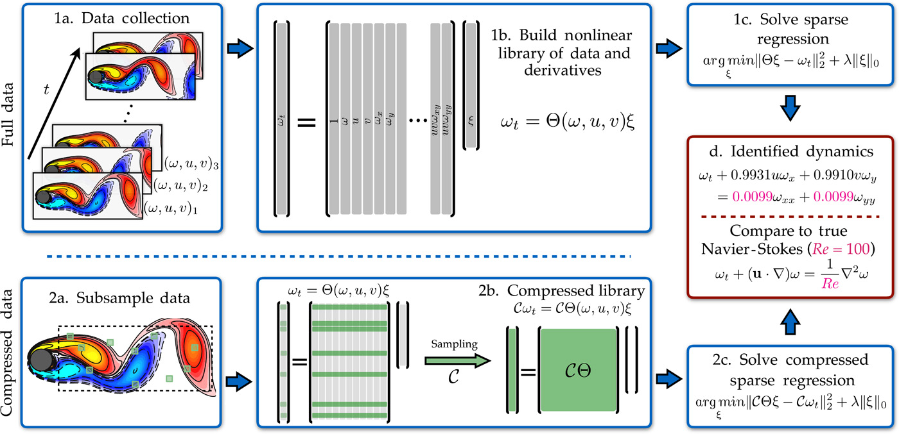
Uses of ML in scientific context
Data-driven discovery of partial differential equations, S. H. Rudy et al., Science Advances, 2017
Discovering governing equations
From observations, infer the underlying partial differential equation
Notes:
Komousakus stuff

Slide 17
Uses of ML in scientific context
Solving partial differential equations
Solving partial differential equations is still of large interest – many engineering and scientific problems can be formalized through a PDE.
Numerical solvers of PDEs are fiddly:
Require parameter tuning
Numerical considerations (e.g.: because of discretization, some systems of PDEs can’t be solved naively)
Computationally expensive
Notes:
Our work, google work, fluid

Slide 18
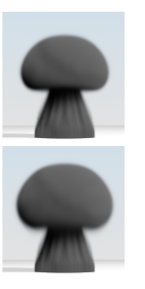
Uses of ML in scientific context
Jonathan Tompson, Kristofer Schlachter, Pablo Sprechmann, and Ken Perlin. 2017. Accelerating eulerian fluid simulation with convolutional networks. In Proceedings of the 34th International Conference on Machine Learning - Volume 70 (ICML'17). JMLR.org, 3424–3433.
Solving partial differential equations – incompressible flow
exact solution (Preconditioner Conjugate Gradient method)
Authors use a Convolutional Neural Network to solve resulting linear system
~100x speed up in comparison to CGD method
~1.5x speed up in comparison to iterative methods
Proposed method
Notes:
Our work, google work, fluid

Slide 19
Uses of ML in scientific context
Fourier Neural Operator for Parametric Partial Differential Equations L. Zongyi et al. arXiv:2010.08895, 2020
Solving partial differential equations – solving full fluid equation
Up to 1000x faster than traditional solvers
Notes:
Our work, google work, fluid

Slide 20
Uses of ML in scientific context
Many other applications:
Tackling previously intractable problems
Inverse modelling
Uncertainty quantification
Parametrisation
Downscaling
Reduced order modelling
Notes:
25 minutes

Slide 21
Limitations of using ML in science
Inconsistency with physical laws
Results which are obviously wrong that can lead to bad results, crash the system
Lack of theoretical guarantees do not inspire confidence
Interpolation versus extrapolation
Cool proof-of-concept projects, but a lot to be done to live up to the hype
Applications in science are stringent:
very good defined notion of what is wrong
traditional applications of machine learning are more forgiving (e.g.: machine translation)
using scientific problems to test machine learning models opens doors to think about how to better make models
Notes:
30 minutes

Slide 22
Incorporating domain knowledge
Respecting the constraints of the problem
Theoretical guarantees
Reducing the space of models in which we are searching
Notes:
Reducing the search space

Slide 23
Incorporating domain knowledge
Soft-constraint vs hard-constraint // invariance vs equivariance
A soft-constraint is some awareness of the constraint, but it’s not not guaranteed to be always respected
A hard-constraint gives the guarantee that the constraint is respected
Typically, a soft-constraint is easier to include, and degrades the performance less
Notes:
These are not formal definitions

Slide 24
Incorporating domain knowledge
Soft-constraint vs hard-constraint // invariance vs equivariance
Function invariance is a function whose output will not change with respect to the invariant property.
E.g.: Laplacian operator is rotation invariant
Function equivariance is a function whose output might change, but the end result does not change (much).
E.g.: typical convolutional neural networks are translation/rotation equivariant
Notes:
These are not formal definitions

Slide 25
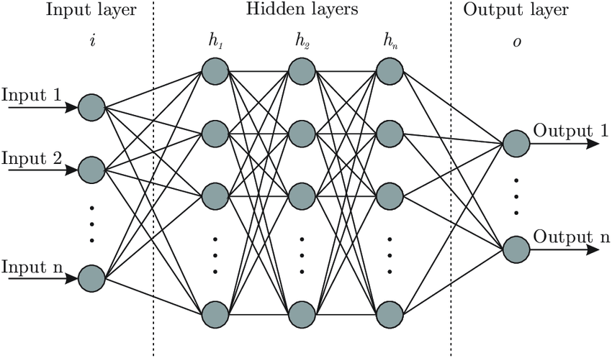
Incorporating domain knowledge
Neural networks
Dense deep neural network
Optimisation strategy
Gradient descent, ADAM, Adamax
Minimizing some measure of optimality
Classification: cross-entropy
Regression: mean squared error
Notes:
Loss function

Slide 26
Incorporating domain knowledge
Neural networks
Modifying loss function:
For example, maybe the target has to be positive, so we penalize the prediction if it is negative.
Notes:
Loss function with external things

Slide 27
Incorporating domain knowledge
Neural networks
The same idea can also enforce bounds in the prediction
We can also use information from the features. For example, for conservation purposes.
Notes:
Loss function with external things

Slide 28
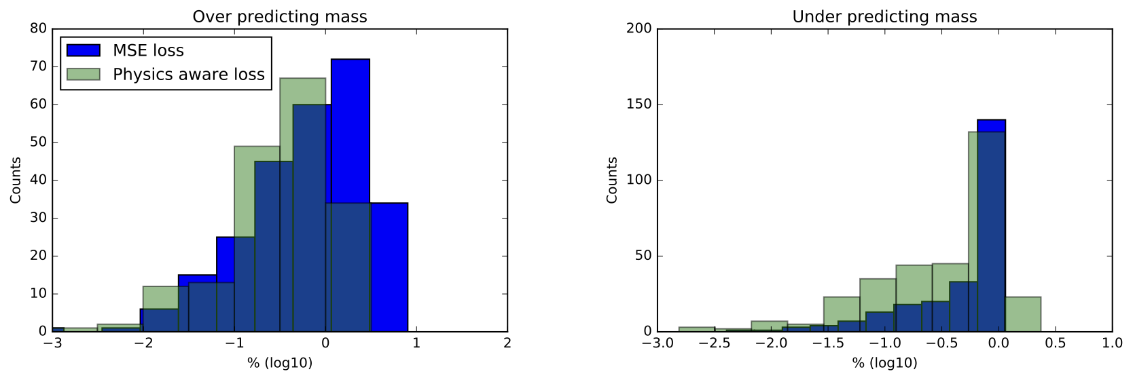
Incorporating domain knowledge
Neural networks

Slide 29
Incorporating domain knowledge
Neural networks

Slide 30
Incorporating domain knowledge
Neural networks
Modifying network architecture:
Change output layer activation from linear to ReLU (or similar)
This is not new, to get a probability, we use a sigmoid!
Notes:
Picture of neural net
Gradient descent
Loss function

Slide 31
Incorporating domain knowledge
Invariance in Neural networks
A mapping is invariant under some group G if
Why is this relevant? Suppose we know something about our problem or our data:
e.g.: should be rotation invariant, permutation invariant, translation invariant
e.g.: images, graphs, some physical quantities
Notes:
Picture of neural net
Gradient descent
Loss function

Slide 32
Incorporating domain knowledge
Invariance in Neural networks
Modifying network architecture for symmetries:
Suppose you want your function to be symmetric for input 1 and 2.
Meaning:
A dirty way to do this is to make an ensemble prediction. Evaluate the model twice and the prediction is the average of both.
Notes:
Let us consider a very concrete example

Slide 33
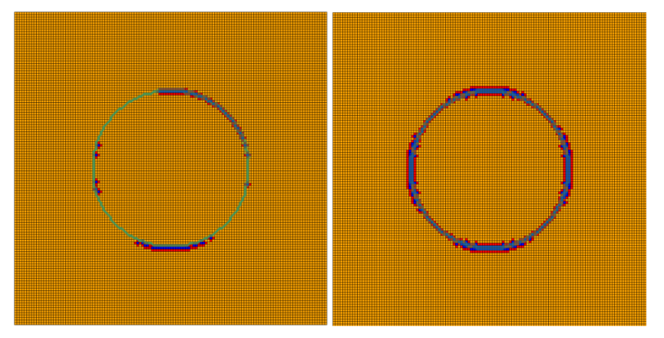
Incorporating domain knowledge
Neural Network-Based Limiter with Transfer Learning, R. Abgrall et al., Communications on Applied Mathematics and Computation (2020)
Notes:
Loss function with external things

Slide 34
Incorporating domain knowledge
Invariance in Neural networks
Modifying network architecture for symmetries:
Suppose you want your function to be symmetric for input 1 and 2.
Meaning:
A dirty way to do this is to make an ensemble prediction. Evaluate the model twice and the prediction is the average of both.
Computationally intractable for most things
Notes:
Picture of neural net
Gradient descent
Loss function

Slide 35
Incorporating domain knowledge
Invariance in Neural networks
A very common way is to do data augmentation.
e.g.: rotation invariance, take datapoint x and generate several gx
Although this is better than nothing, there are better options
On the Benefits of Invariance in Neural Networks, C. Lyle et al., arXiv:2005.00178
Notes:
Picture of neural net
Gradient descent
Loss function

Slide 36
Incorporating domain knowledge
Invariance in Neural networks
A very common way is to do data augmentation.
e.g.: rotation invariance, take datapoint x and generate several gx
Although this is better than nothing, there are better options
Feature averaging can be seen as symmetrizing function f by averaging over G:
On the Benefits of Invariance in Neural Networks, C. Lyle et al., arXiv:2005.00178
Notes:
In practice, we do not consider all g, but an average of f(gx) evaluated at some g.
In this paper, it is shown that FA is favorable to DA. These are two methods which are performed without touching the neural network
There are other works which use similar ideas, and even some which change the structure of the neural network, but I am not so familiar with this work

Slide 37
Incorporating domain knowledge
In other methods
Machine Learning is not just neural networks
Additive methods – finding the appropriate basis functions (e.g.: positivity preserving, bounded)
The narrative about loss functions can also be used for other methods. e.g.: xgboost
Kernel methods, such as Gaussian Processes can also be tailored to be constrained – mathematically rigorous but also complicated computationally
A survey of constrained gaussian processes regression: approaches and implementation challenges, L. Swiler et al., Journal of Machine Learning for Modeling and Computing, 2020
Notes:
Ml is not just neural networks – possibly in other methods this is also possible – and mioght make sense to make this discussion
For example, xgboost is also optimizing a loss through a gradient computation – we can also change the loss fct there
Another class of methods are kernel methods, let me talk a little bit about guassian processes and mention a paper which reviews different ways to include constraints in GPs

Slide 38
Towards the future?
Towards a Mathematical Understanding of Neural Network-Based Machine Learning: what we know and what we don’t, W. E et al., arXiv:2009.10713
Machine learning (Deep Learning) is still sometimes perceived as ”black box” or magic. This is due to:
We lack basic understanding of the fundamental reasons behind its success
Models’ performance is often very sensitive to hyperparameters
Some techniques, such as batch normalization, appear to be black magic
We should understand the reasons behind the success and fragility of neural network-based models and find ways to formulate more robust models.
Notes:
Weinan E, a professor in Princeton well known in the field of computational mathematics has been trying to put Machine learning in a similar framework
In numerics, we have proofs of convergence, error bounds and when we don’t have analytical solutions (for most nonlinear problems), we have benchmark problems that give us an impression

Slide 39
Towards the future?
Towards a Mathematical Understanding of Neural Network-Based Machine Learning: what we know and what we don’t, W. E et al., arXiv:2009.10713
Regression problem:
Choose the hypothesis space
Polynomials, wavelets, CART
Neural networks
Define loss function
“empirical risk”
regularization / constraints
Optimization algorithm / parameters
Gradient descent, stochastic gradient descent
Hyperparameters
Notes:
Regression/classification problem is nothing more than finding the appropriate function that maps inputs to outputs – function approximation
We can use tools from approximation theory to try to undertand machine learning / why and how it works
3 main steps

Slide 40
Towards the future?
Towards a Mathematical Understanding of Neural Network-Based Machine Learning: what we know and what we don’t, W. E et al., arXiv:2009.10713
Regression problem:
Choose the hypothesis space
Polynomials, wavelets, CART
Neural networks
Define loss function
“empirical risk”
regularization / constraints
Optimization algorithm / parameters
Gradient descent, stochastic gradient descent
Hyperparameters
Goal: Minimize the generalization error
Notes:
Regression problem, 3 main steps:

Slide 41
Towards the future?
Towards a Mathematical Understanding of Neural Network-Based Machine Learning: what we know and what we don’t, W. E et al., arXiv:2009.10713
Regression problem:
Choose the hypothesis space
Polynomials, wavelets, CART
Neural networks
Define loss function
“empirical risk”
regularization / constraints
Optimization algorithm / parameters
Gradient descent, stochastic gradient descent
Hyperparameters
Special function spaces, e.g: positive preserving, L2-integrable, bounded, symmetric, etc.
Goal: Minimize the generalization error
Notes:
Regression problem, 3 main steps:

Slide 42
Towards the future?
Towards a Mathematical Understanding of Neural Network-Based Machine Learning: what we know and what we don’t, W. E et al., arXiv:2009.10713
Regression problem:
Choose the hypothesis space
Polynomials, wavelets, CART
Neural networks
Define loss function
“empirical risk”
regularization / constraints
Optimization algorithm / parameters
Gradient descent, stochastic gradient descent
Hyperparameters
Special function spaces, e.g: positive preserving, L2-integrable, bounded, symmetric, etc.
Loss function thinkering / including constraints as penalization terms
Goal: Minimize the generalization error
Notes:
Regression problem, 3 main steps:

Slide 43
We are on a break

